Slide 1
What are Atmospheric Jets and why do they exist?

Slide 2
Atmospheric Layers
High up in the atmosphere, at the top of a layer that meteorologists call the “troposphere”, air is generally restricted from going any higher.

Slide 3
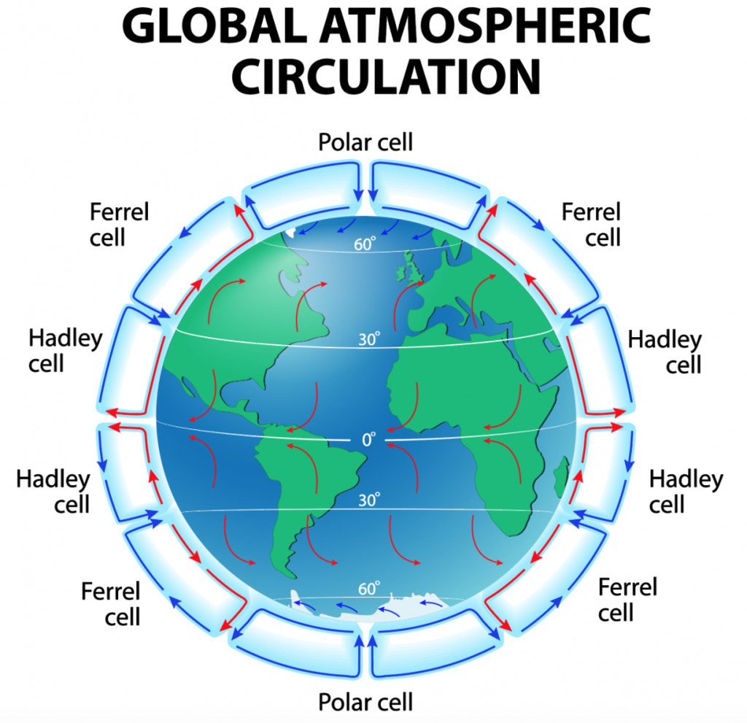
Climate Cell Boundaries
The height of the troposphere changes with latitude, which leads to strong pressure/height gradients at specific locations.
These locations mark the boundaries between the three Climate Cells, called the Hadley Cell (in the tropics), the Ferrell Cell (in the mid-latitudes), and the Arctic Cell (in the polar regions).

Slide 4
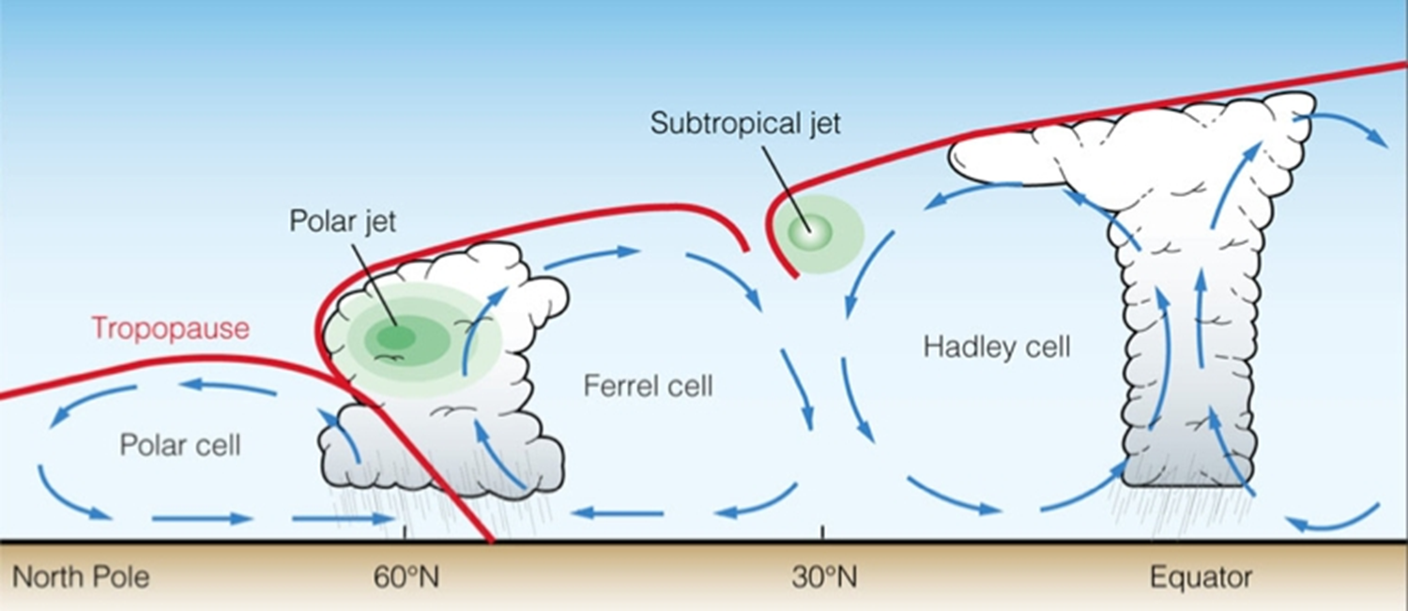
Atmospheric Jets
Along the boundary between the Ferrell and Arctic cells, there is a strong pressure/height gradient at the top of the troposphere.
This leads to a strong area of winds called the Polar Jet, or more commonly, the Jet Stream.
Other jets exist between the Hadley and Ferrell cells, but they are generally weaker and/or smaller than the Polar Jet.

Slide 5
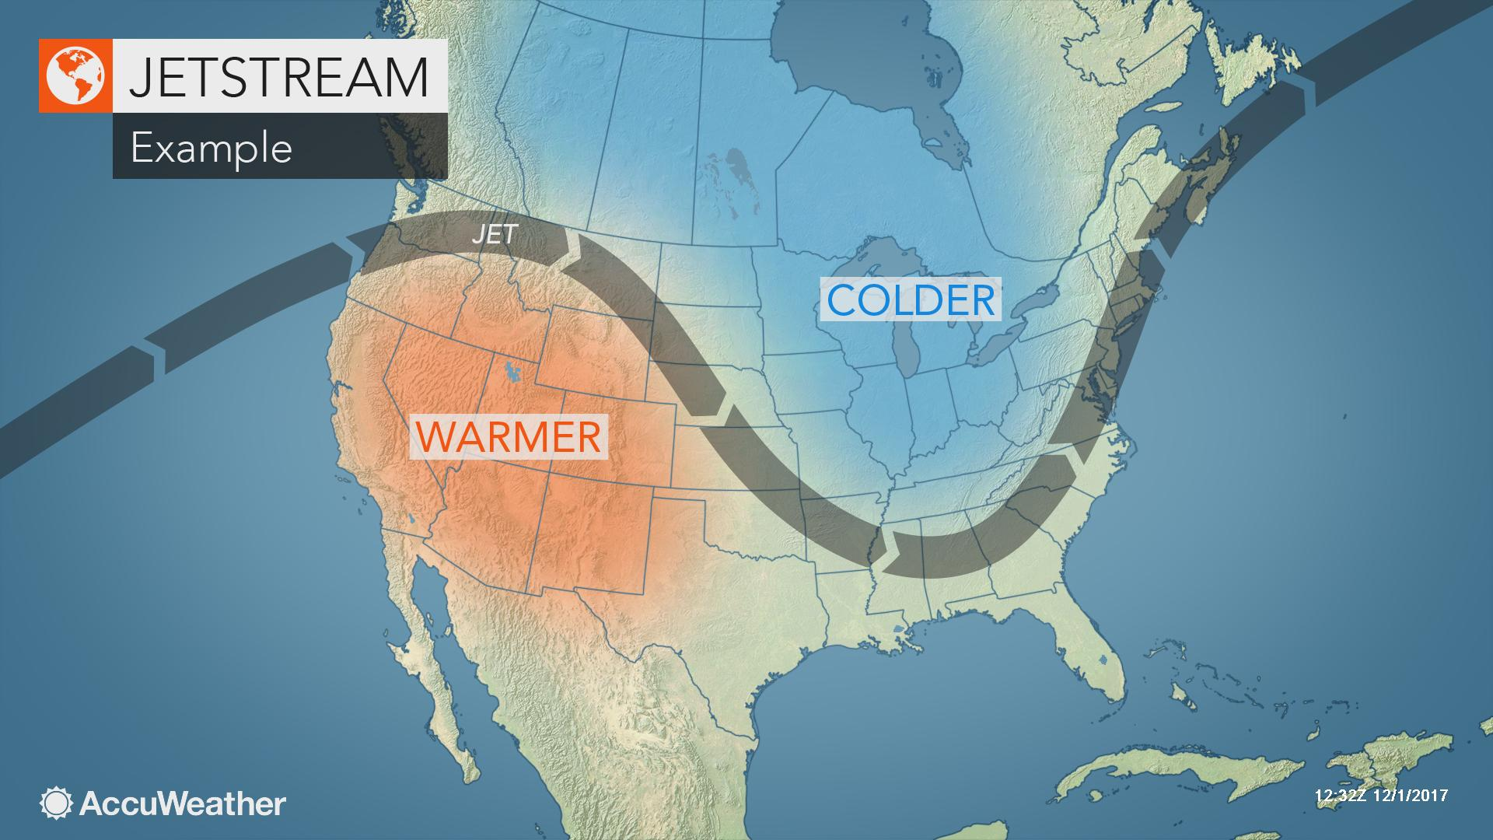
Influencing Weather Patterns
Changes in the location, intensity, and orientation of the Jet Stream are a key factor in defining and predicting weather patterns in the mid-latitudes.
Meteorologists look for waves in the Jet Stream, known as ridges and troughs, to define the location of certain weather types.

Slide 6
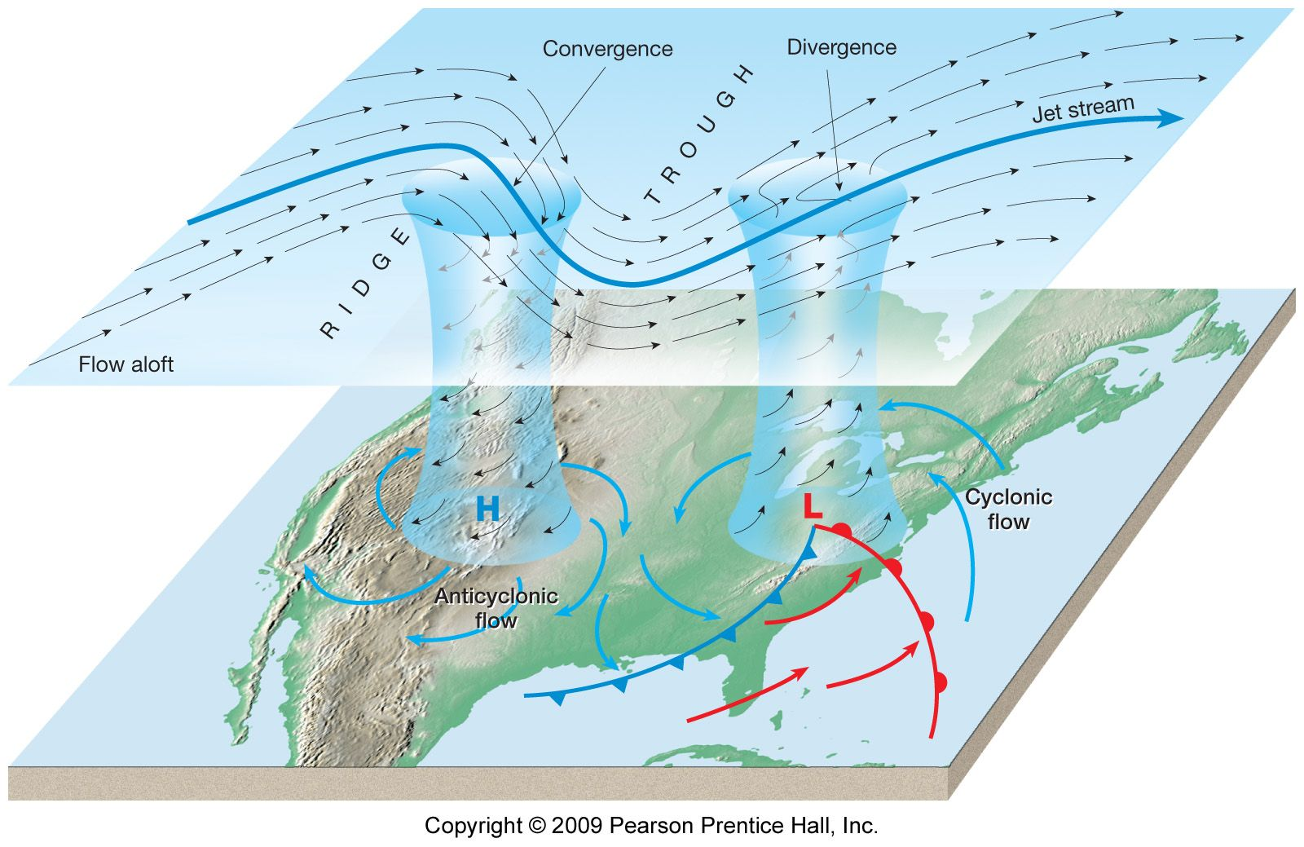
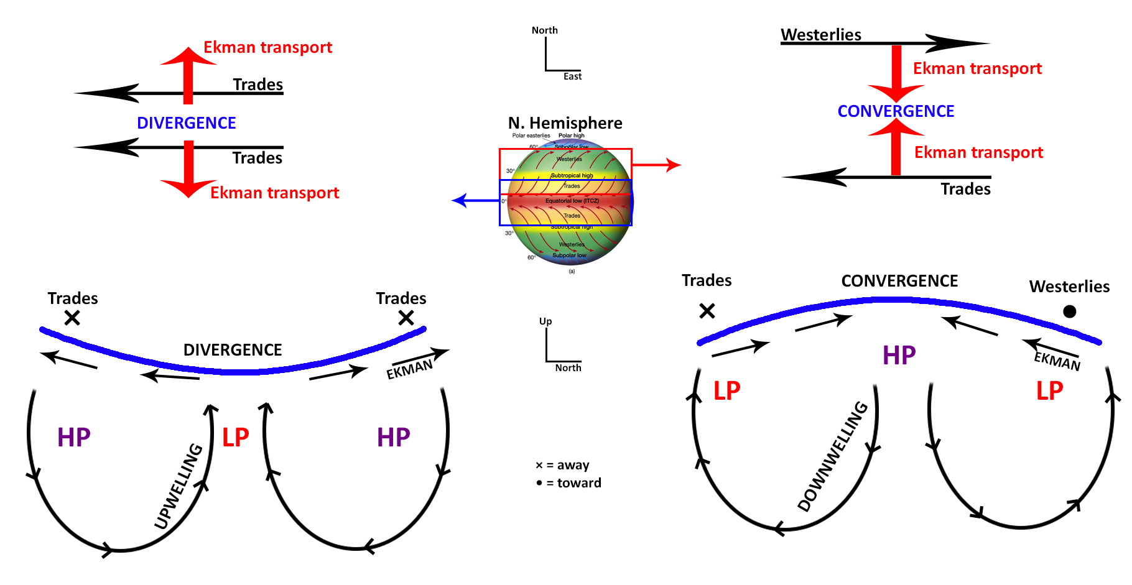
Changed in Wind Speed and Direction
Large changes in wind speed and/or direction can lead to localized spin, or “vorticity”, and also wind “divergence”.
Think of cars moving along a highway. Changes in speed and/or direction at one point can lead to traffic jams at other places.

